Slide 1
A CURRENT GLOBAL PERSPECTIVE ON THE EPIDEMIOLOGY AND NATURE OF THE DEMENTIAS, THEIR GLOBAL IMPACT, PRESSING CHALLENGES AND WHAT IT WOULD MEAN IF DEMENTIA WERE A MAJOR PUBLIC HEALTH PRIORITY
Sube Banerjee
Professor of Dementia
Centre for Dementia Studies
Brighton and Sussex Medical School

Slide 2


Slide 3
we need to know much more about dementia
Challenges and solutions - 1

Slide 4
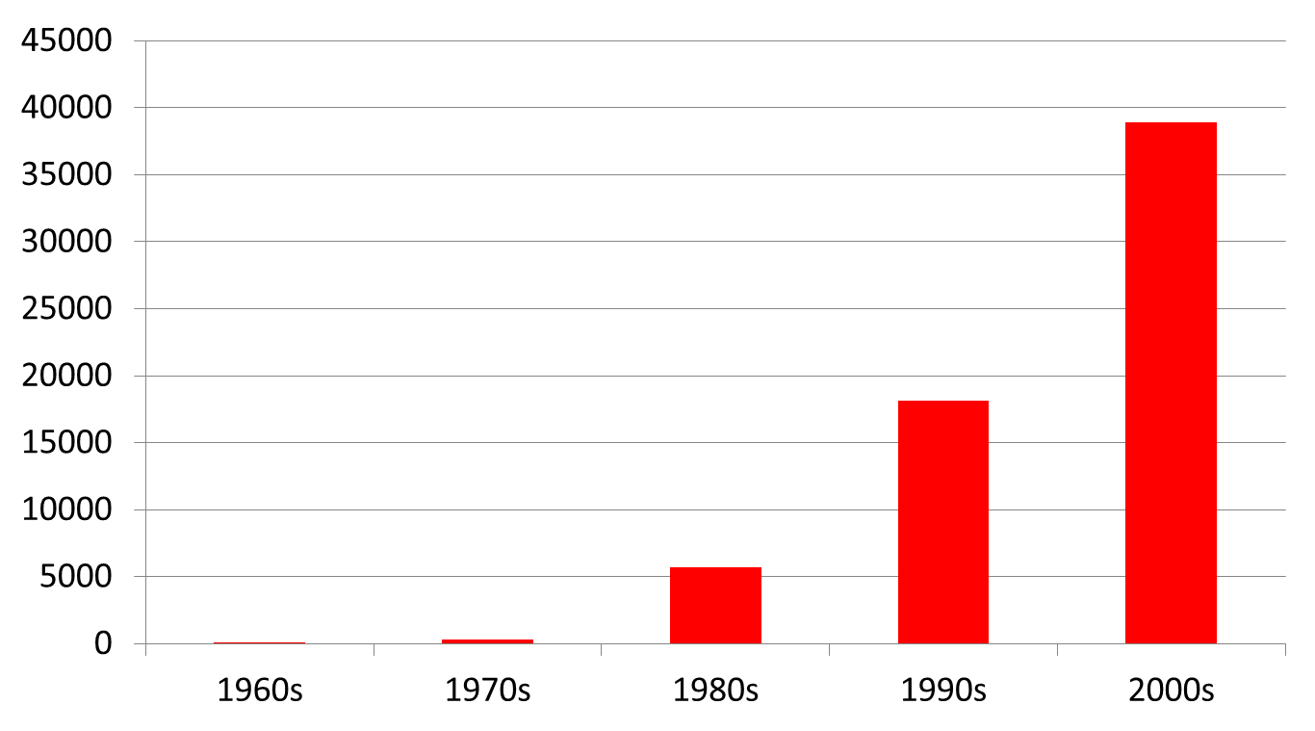
Numbers of papers on Alzheimer’s Disease by decade
290

Slide 5
Disorders of the brain and mind are leading contributors to disability and dependence
Health condition/ impairment | Mean population attributable fraction (Dependence) | Mean population attributable fraction (Disability)
1. Dementia | 36.0% | 25.1%
2. Limb paralysis/ weakness | 11.9% | 10.5%
3. Stroke | 8.7% | 11.4%
4. Depression | 6.5% | 8.3%
5. Visual impairment | 5.4% | 6.8%
6. Arthritis | 2.6% | 9.9%
Sousa et al, Lancet, 2009; BMC Geriatrics 2010

Slide 6
Growth of numbers of people with dementia
The World Alzheimer Report (2009) estimated:
  35.6 million people living with dementia worldwide in 2010
  Increasing to 65.7 million by 2030
  115.4 million by 2050

Slide 7








Numbers of people with dementia by world region (2015-2050)
2015
2020
2025
2030
2035
2040
2045
2050
16.02
4.73
8.20
3.24
11.74
4.78
63.16
19.62
8.68
3.93
12.35
3.04
18.78
135.46
4.66
North America
Europe Central and Eastern
47.47
Latin America & Caribbean
Asia (high income)
Africa and the Middle East
Asia (low and middle income)
Europe Western
World

Slide 8
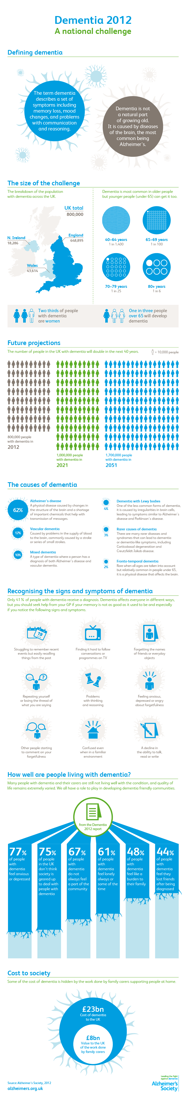
Alzheimer’s Society, March , 2012

Slide 9


Slide 10
Worldwide cost of dementia
The societal cost of dementia is already enormous.
Dementia is already significantly affecting every health and social care system in the world.
The economic impact on families is insufficiently appreciated.
The total estimated worldwide costs of dementia are US$604 billion in 2010.
These costs are around 1% of the world’s GDP
  0.24% in low income
  1.24% in high income

Slide 11
Worldwide costs of dementia
The World Alzheimer Report (2010) estimated that:
If dementia care were a country, it would be the world’s 18th largest economy

Slide 12
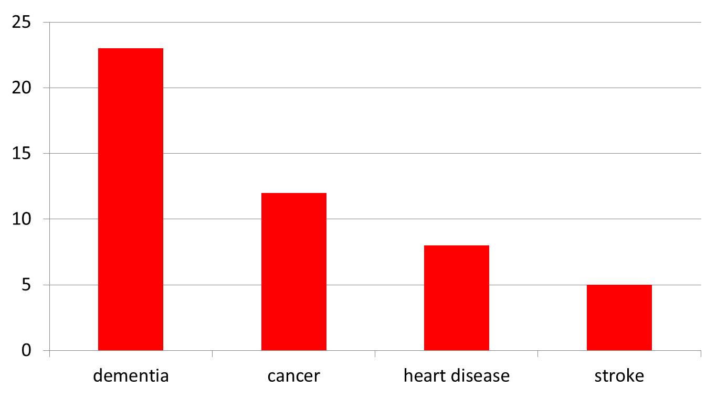
Cost of illness per year (£billion)

Slide 13
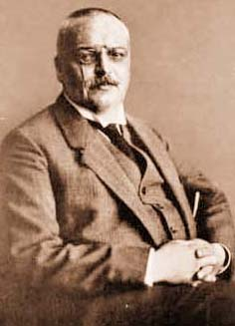
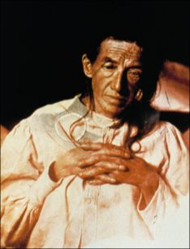
Ich hab mich verloren
Dr Alois Alzheimer
1864 - 1915
Mrs Auguste Deter
1850 - 1906

Slide 14


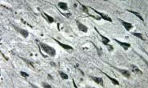
Amyloid cascade hypothesis
Environment
Genes

Slide 15
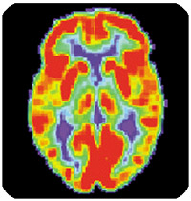
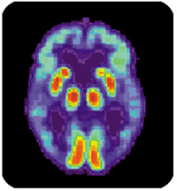
The Changing Brain in Alzheimer’s Disease
Pet Scan of Normal Brain
Pet Scan of brain in Alzheimer’s Disease

Slide 16
improving public and professional attitudes and understanding

Slide 17
National dementia strategies
France
Wales
Scotland
Australia
Germany
Japan
South Korea
India
England
…

Slide 18
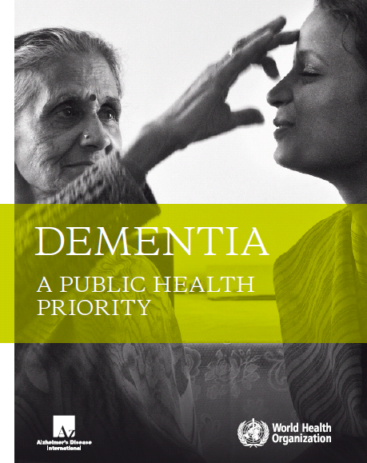
WHO Report, 2012
  Prevalence
  Numbers
  New incidence data
  Cost
  Policy
Dr. Margaret Chan, Director General, WHO
“I call upon all stakeholders to make health and social care systems informed and responsive to this impending threat”

Slide 19
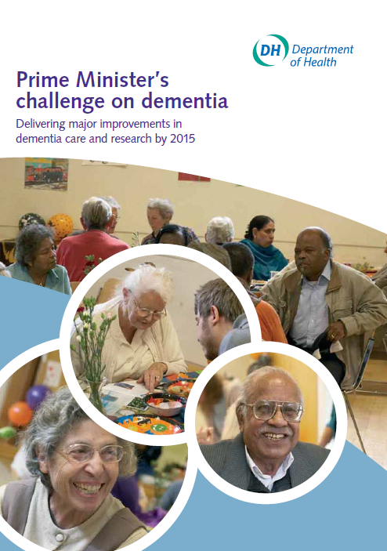
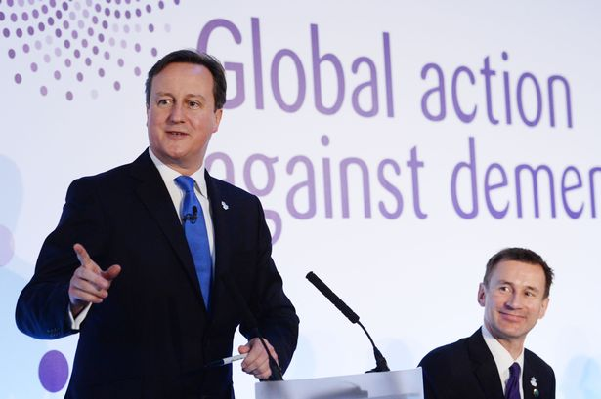
PM Challenge and
G8 Dementia Summit
“So I am determined that we will go further and faster on dementia – making life better for people with dementia and their carers, and supporting the research that will ultimately help us slow, stop and even prevent the condition”

Slide 20
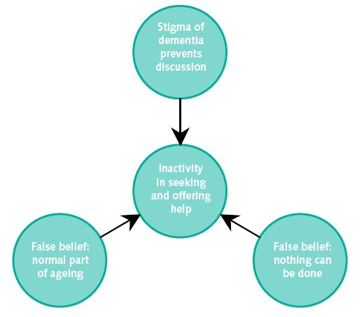
Dismantling the barriers to care: improving public and professional attitudes and understanding

Slide 21
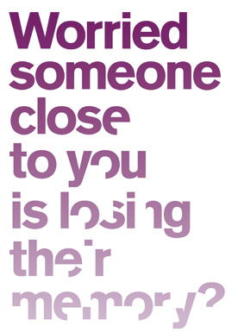
Health promotion, education
Many people suffer
from memory loss
as they get older.
But if it starts
to happen on
a regular basis,
it could be the early
signs of dementia.
If you’re worried, see your doctor

Slide 22
Change the word – Japan, we need to change the beliefs
Chihō
Ninchishō
痴
呆
認知
症
Idiocy
Stupidity
Cognition
Disorder
In 2004, the Japanese Government modified the Japanese terminology for "Dementia"

Slide 23
we need earlier and better diagnosis of dementia
Challenges and solutions - 2

Slide 24
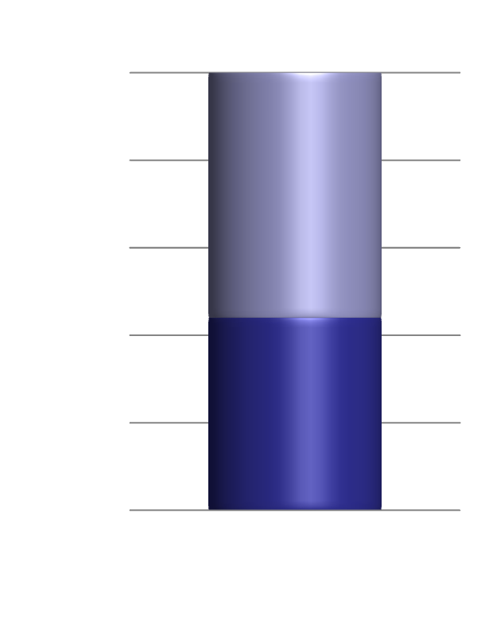
The fundamental problem - now
Only around 48% of people with dementia receive any specialist health care assessment or diagnosis
When they do, it is:
  Late in the illness
  Too late to enable choice
  At a time of crisis
  Too late to prevent harm and crises

Slide 25
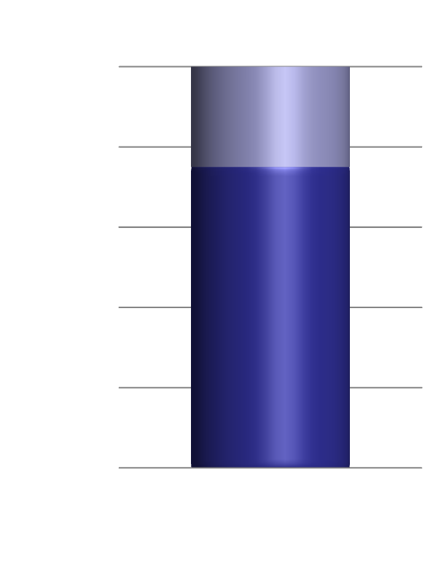
The goal
70-80% of people with dementia receive accurate assessment and diagnosis
When they do, it is:
  Early in the illness
  Early enough to enable choice
  In time to prevent harm
  In time to prevent crises
Late and low diagnosis
Early and high diagnosis

Slide 26
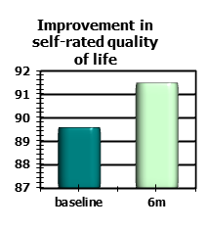
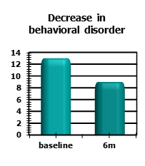
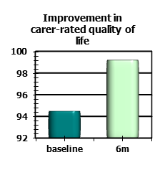
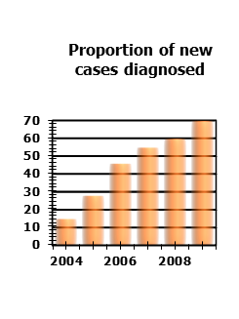
Services for early diagnosis and intervention in dementia for all – markers of quality
Working for the whole population of people with dementia
  ie has the capacity to see all new cases of dementia in their population
Working in a way that is complementary to existing services
  About doing work that is not being done by anybody
Service content
  Make diagnosis well
  Break diagnosis well
  Provide immediate support and care immediately from diagnosis
Banerjee et al 2007, IJGP

Slide 27
Early intervention for dementia is clinically and cost effective – “spend to save”
215,000 people with dementia in care homes -- £400 per week
Spend on dementia in care homes pa
  £7 billion pa
22% decrease in care home use with early community based care
28% decrease in care home use with carer support (median 558 days less)
Quality – older people want to stay at home, higher qol at home
Take an additional 220 million pa
Delayed benefit by 5-10 years
  Strategic head needed
Model published by DH
20% releases £250 million pa y6

Slide 28
What do we mean by early diagnosis?

Slide 29
Where are we in diagnostics?
A simple quick diagnostic test that tells us if we have dementia x
A simple efficient screening test that would work in populations to identify those with high likelihood of dementia x
Accurate diagnosis by careful clinical assessment with multi-disciplinary synthesis of history, examination and investigation ✔
Tests to help make decisions about diagnosis and sub-diagnosis ✔
Tests to make that diagnosis for us x
BE WARY OF THE DIFFERENCE BETWEEN RESEARCH AND PRACTICE

Slide 30
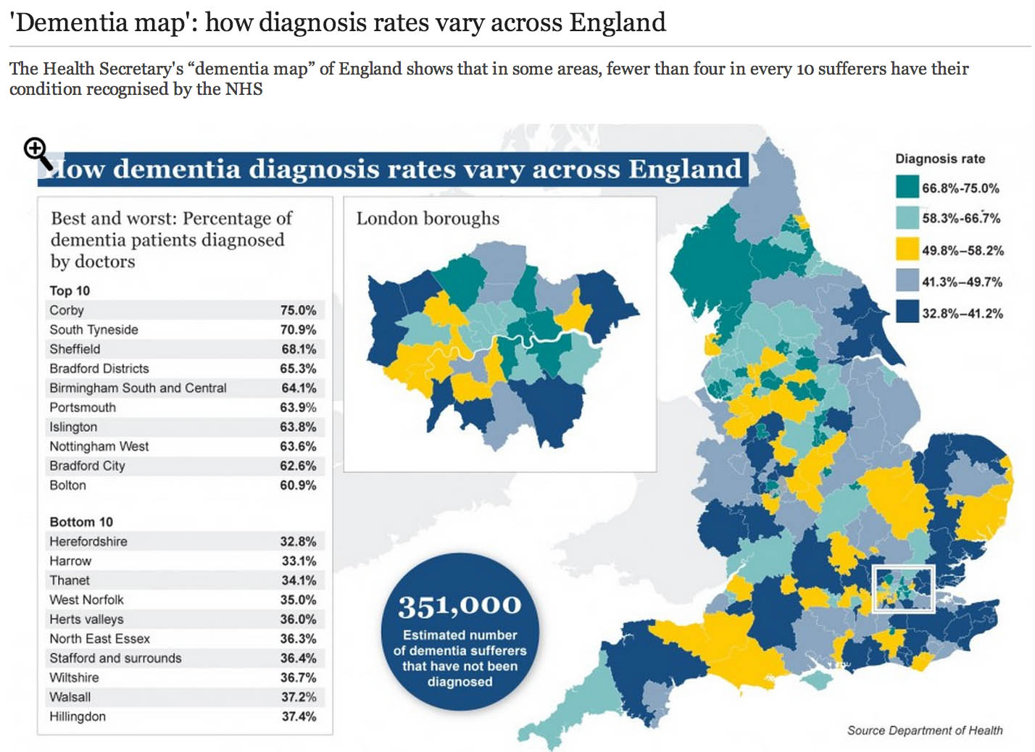

Slide 31
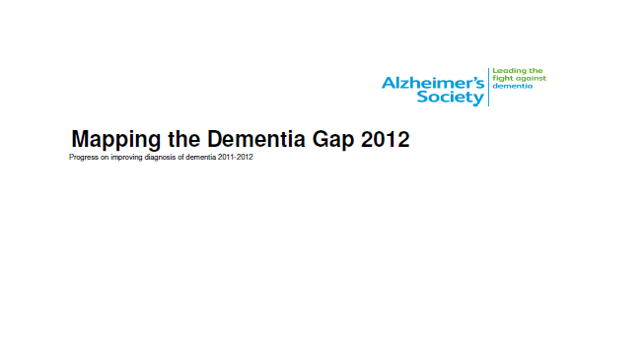
Tracking cases on GP QOF dementia registers
2011 - 41%
2012 - 44%
2013 - 48%

Slide 32
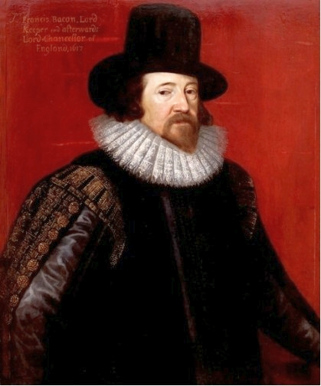
"scientia potestas est" Meditationes Sacrae (1597)
Francis Bacon
  1561 to 1626
Founder of empiricism and the scientific method
knowledge is power

Slide 33
What is diagnosis for? Production of health and wellbeing in dementia
How we turn people with worrying symptoms
into people who know what is going on
How we turn toxic uncertainty
into empowered understanding
How we enable choice, self-efficacy
and quality of life and quality of care

Slide 34
we need better prevention and treatment of dementia from diagnosis to end of life
Challenges and solutions - 3

Slide 35
Improving quality of care
Improved home care
Improving support for carers
Improved quality of care for dementia in general hospitals
Improved intermediate care for people with dementia
Housing support and telecare
Living well with dementia in care homes
Improved end of life care for people with dementia

Slide 36
The acute end of the dementia pathway
70% hospital beds occupied by older people, half of them have dementia
Dementia is a predictor of increased LOS, poorer outcomes and institutionalisation
30% of elderly patients with dementia, admitted into acute hospitals from their own homes are discharged into care homes
Notes:
National Dementia Strategy Impact Assessment identified annual savings of £130 million from 2013-14, based on delaying entry to care homes through early diagnosis and intervention.
NAO identified additional savings, including specialist liaison services in hospital, shifting care out of hospital into intermediate care beds…

Slide 37
Evaluation RAID model – effect of geriatric psychiatric liaison services in a general hospital
Reducing Length of Stay
Increasing rates of discharge at MAU
A&E diversion
More home discharges
Reducing rates of re-admissions
Saving 12m - 12,951 bed days
35 beds per day - £3m pa
8% increase admission prevention
6 beds per day
Discharge home
Before 34% - after 67%
Readmission rates
Before 19% - after 5%
Total savings:
£3.55 million to NHS
Money value
Cost:return = £1:£4
At least 44 beds/day
£60,000/week to social care cost

Slide 38
Reduced use of antipsychotic medication

Slide 39
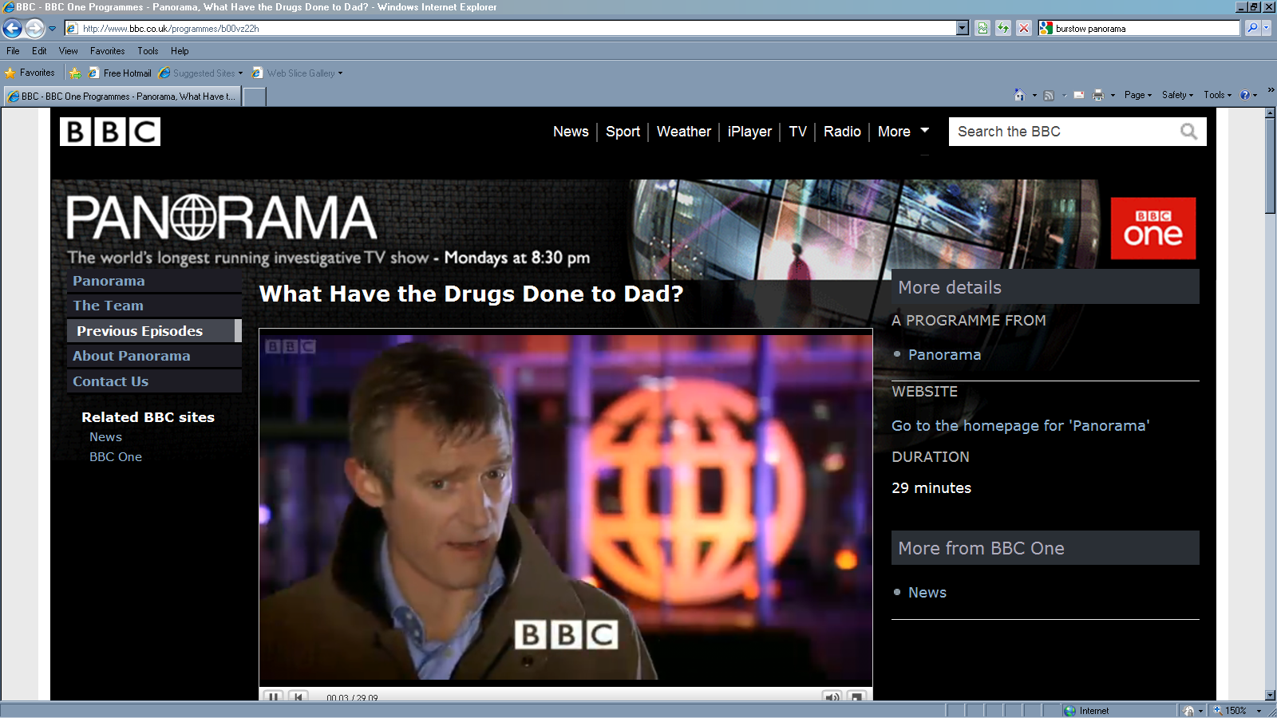
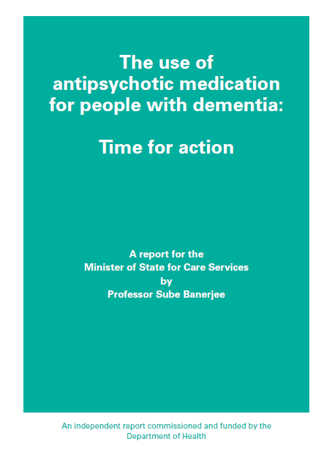
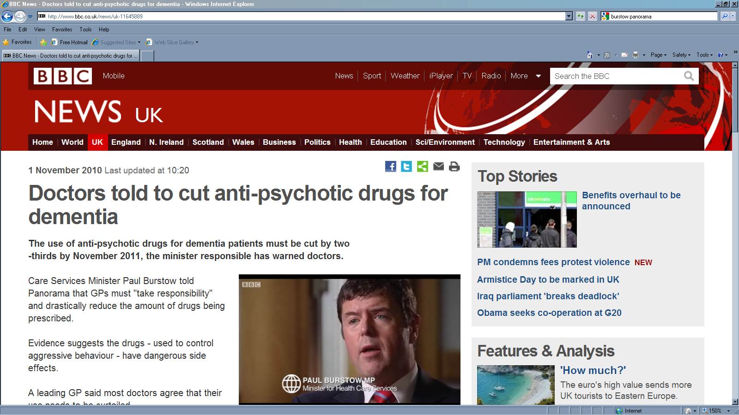
Ministerial review of use of antipsychotics in dementia – simple actionable messages from research
Use quality
improvement
mechanisms
Improve
skills in
primary and
social care
Provision
of specialist
input
Published November 2009
Estimates for the report
  25% people with dementia receiving an antipsychotic
  180,000 people with dementia receiving an antipsychotic
For UK
  1,800 deaths per year
  1,620 severe CVAEs per year

Slide 40
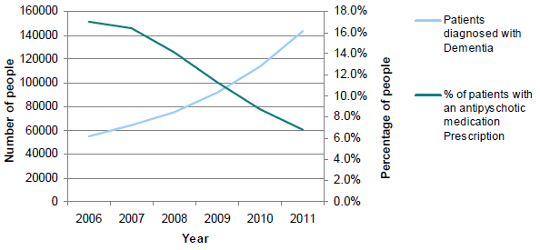
National Audit of antipsychotics in dementia

Slide 41


Slide 42
“The future is unwritten”
Joe Strummer

Slide 43
Thank you!

